Slide 1
NanoTHERM: A FOURIER-BOLTZmann framework for full chip thermal simulations
Shashank Varshney⁺, hameedah sultan⁺, palkesh jain*. Smruti Ranjan Sarangi⁺
* Department of Computer Science and Engineering IIT Delhi, India ⁺ Qualcomm India

Slide 2
Motivation
3
Need of thermal simulators
Existing simulators’ problems
To enable thermal aware design
To compute leakage power
To reduce design time
To capture self heating
FEM or FDM based
Slow
Mesh sensitive
Ignore quantum effects

Slide 3
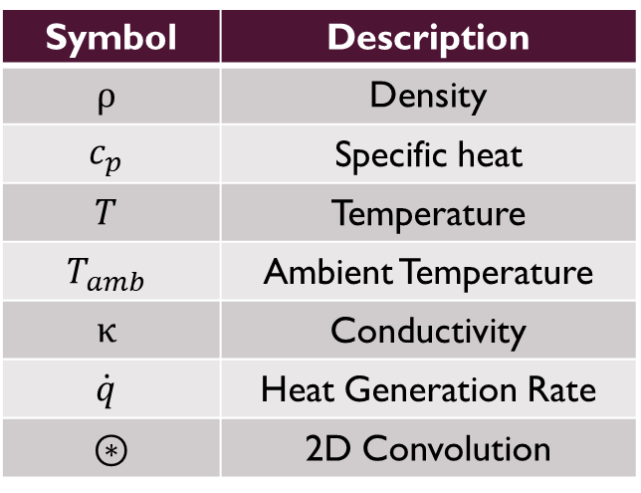
Background
Finite Difference
$ρc_{p}\frac{∂T}{∂t}= ∇∙\left(κ∇T\right)+\dot{q}$
𝜌𝑐_𝑝 𝜕𝑇/𝜕𝑡= 𝛻∙(κ𝛻𝑇)+𝑞 ̇
Green’s function
Impulse response of a unit power source
$$T=G ⊛ P$$
𝑇=𝐺 ⊛ 𝑃
Fourier heat equation
Symbol | Description
$$ρ$$ | Density
$$c_{p}$$ | Specific heat
$$T$$ | Temperature
$$T_{amb}$$ | Ambient Temperature
$$κ$$ | Conductivity
$$\dot{q}$$ | Heat Generation Rate
$$⊛$$ | 2D Convolution

Slide 4

Thermal modeling Approach
Analytically
Green’s function
$$G⊛P$$
Final temperature profile
Geometry
Power profile

Slide 5
OVERVIEW
The standard thermal modeling approach involves solving the Fourier heat equation
At the nanoscale level, the Fourier equation fails to hold because of quantum effects
The Boltzmann transport equation (BTE) needs to be solved
Computationally expensive
We propose a hybrid Fourier-Boltzmann framework to model chip level as well as nanoscale effects
Balance speed and accuracy

Slide 6
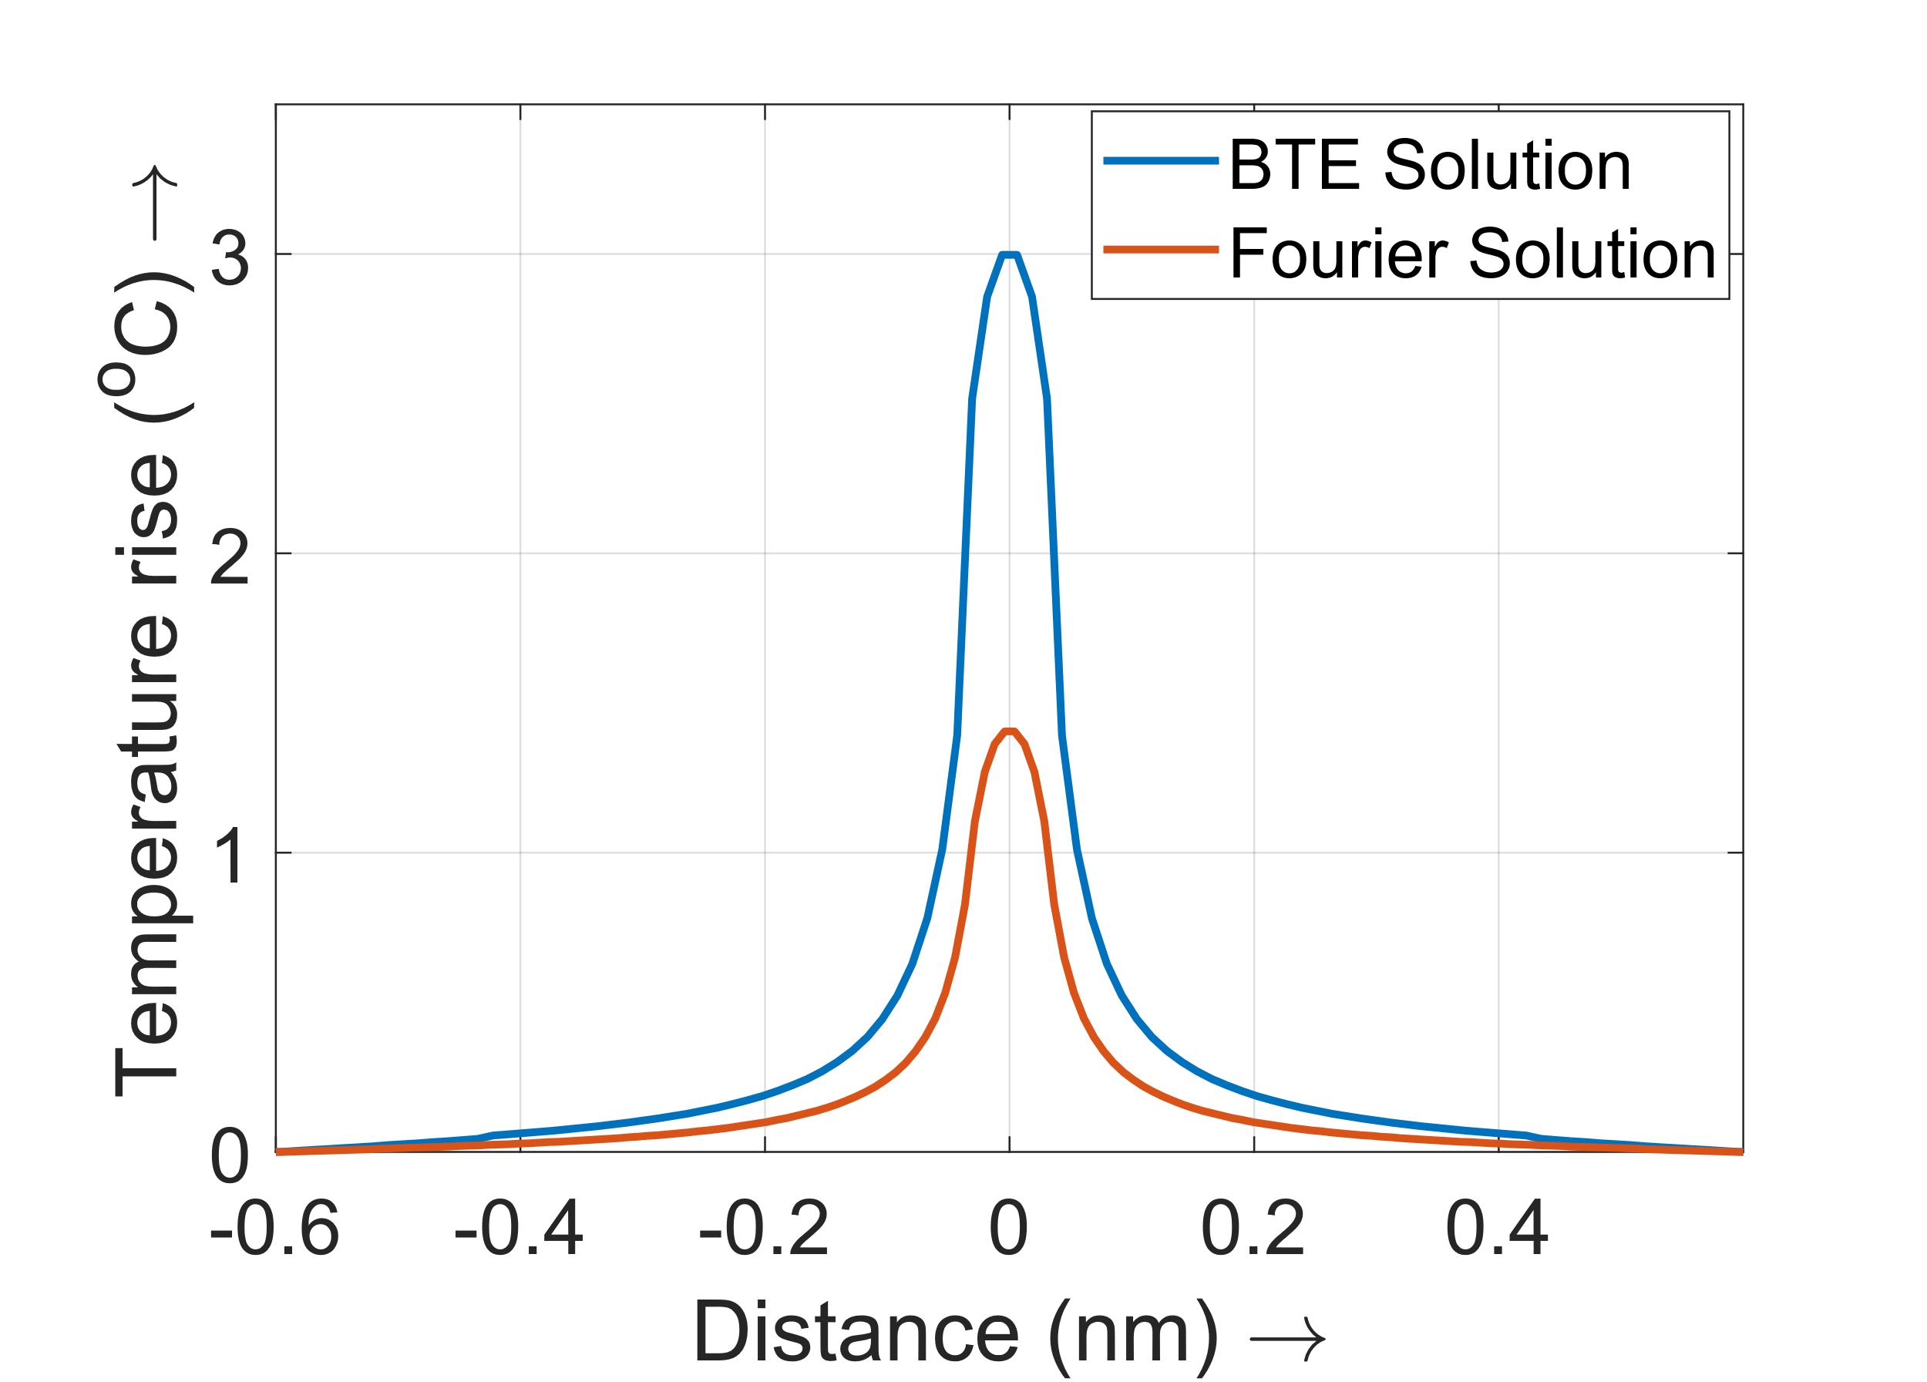
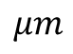
FOURIER-BTE COMPARISON
We compare the BTE steady state solution against the Fourier steady state solution
Maximum error of 53% using the Fourier solution, with respect to the BTE solution.
Ignoring nanoscale effects leads to large errors
$$μm$$
Comparison of Fourier and BTE solutions

Slide 7
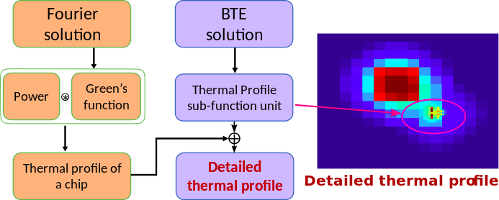
NANOTHERM
We have developed an analytical Fourier-Boltzmann framework to model a full chip by combining architectural level and nanoscale level thermal effects. We call our tool, NanoTherm
Overview of the algorithm

Slide 8





NANOSCALE THERMAL MODELING
Chip level
thermal
simulation
Nanoscale level
thermal simulation
Combined chip level and nanoscale level

Slide 9
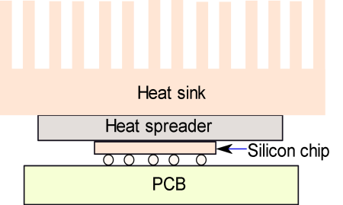
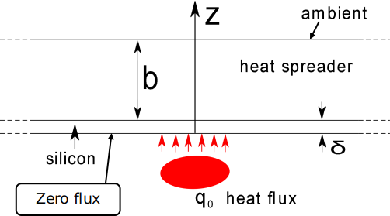
ARCHITECTURAL THERMAL SIMULATIONS:
SYSTEM LAYOUT
System layout
Approximated model

Slide 10
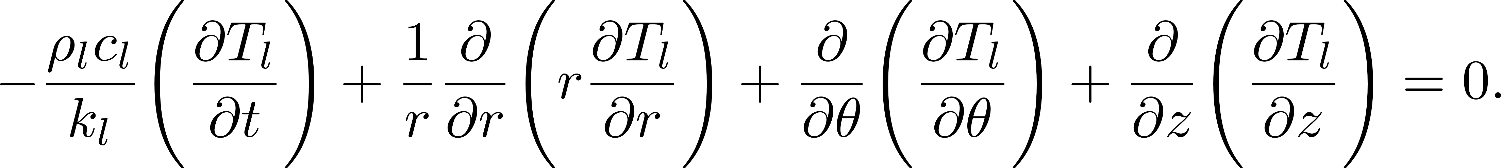
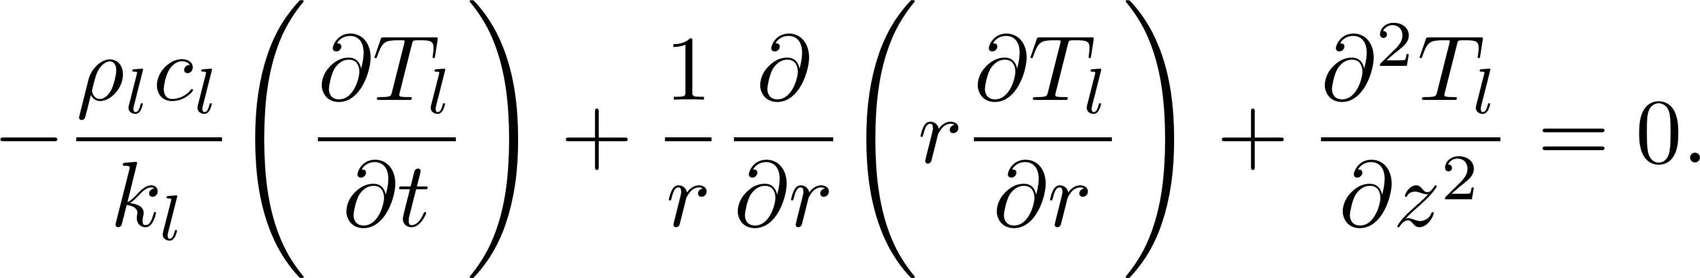


ARCHITECTURAL THERMAL SIMULATIONS:
SYMMETRIC THERMAL DISTRIBUTION
Fourier heat equation:
Symmetry in thermal distribution:
Circular power
source
Symmetric temperature distribution

Slide 11
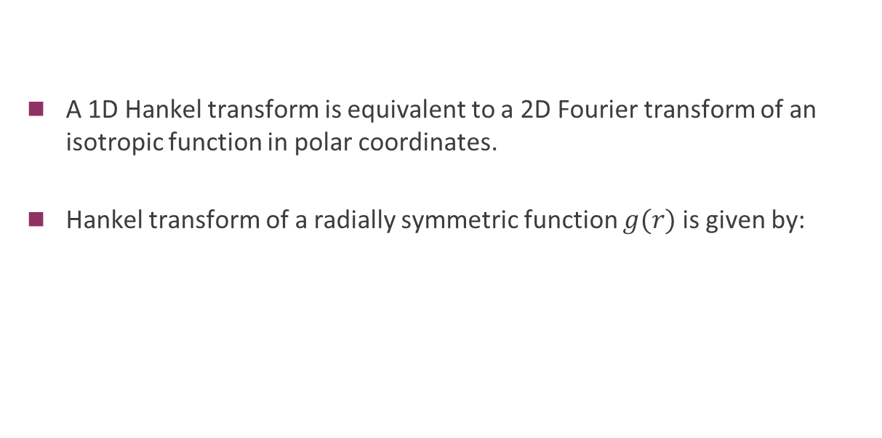
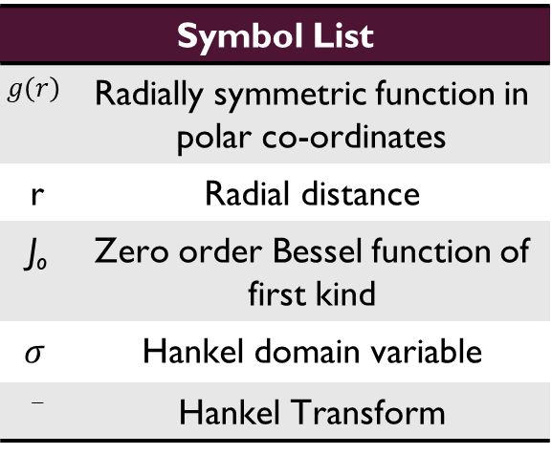
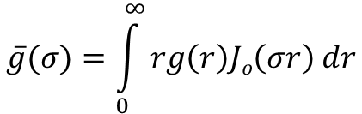
Theoretical Tool Used: Hankel Transform
A 1D Hankel transform is equivalent to a 2D Fourier transform of an isotropic function in polar coordinates.
Hankel transform of a radially symmetric function $g(r)$is given by:
Symbol List
$$g\left(r\right)$$ | Radially symmetric function in polar co-ordinates
r | Radial distance
J_{o} | Zero order Bessel function of first kind
$$σ$$ | Hankel domain variable
_{ˉˉ} | Hankel Transform
$$\overline{g}(σ)=\int_{0}^{∞}{rg\left(r\right)Jo\left(σr\right) dr}$$

Slide 12
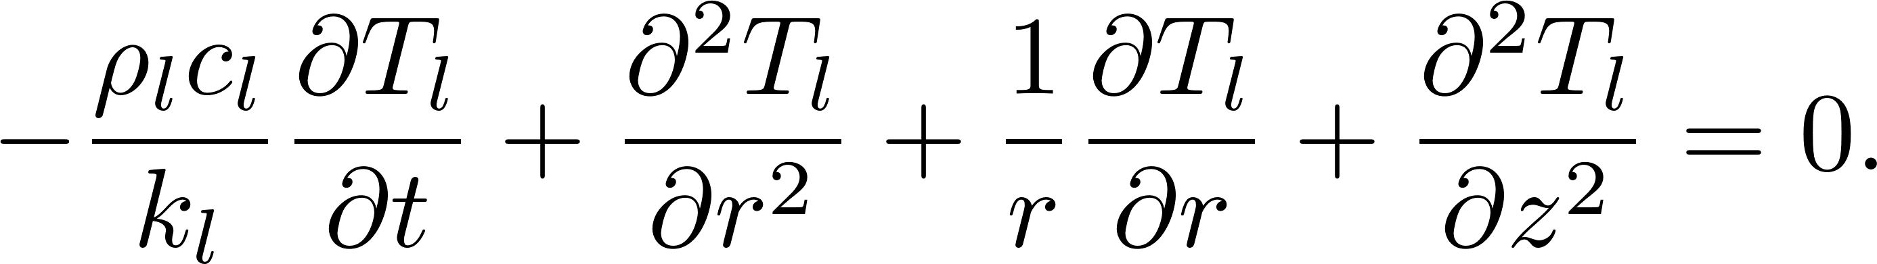
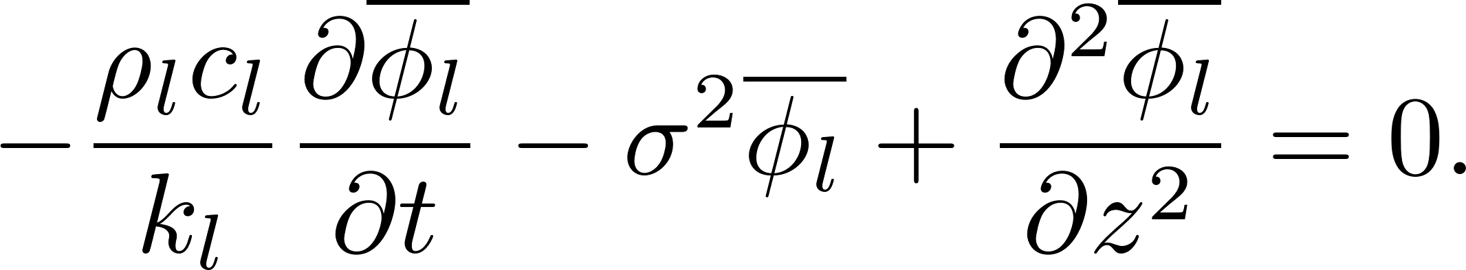
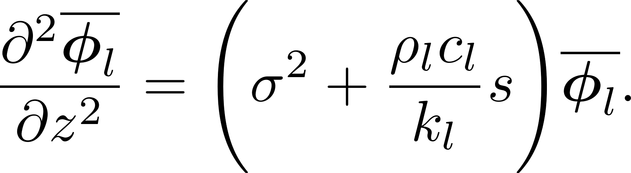
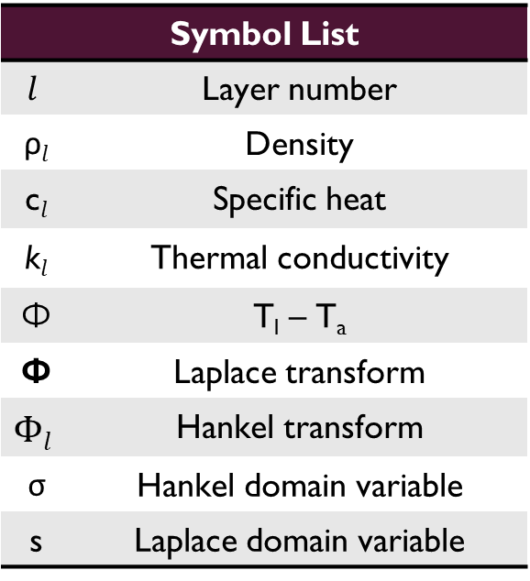
ARCHITECTURAL THERMAL SIMULATIONS
Fourier heat equation:
Symbol List
$$l$$ | Layer number
ρ$l$ | Density
c$l$ | Specific heat
k$l$ | Thermal conductivity
Φ | T_{l} – T_{a}
Φ | Laplace transform
$$Φl$$ | Hankel transform
σ | Hankel domain variable
s | Laplace domain variable
Zero order Bessel differential operator
Using the Hankel transform:
Time derivative
Using the Laplace transform:
This is a standard ordinary differential equation

Slide 13
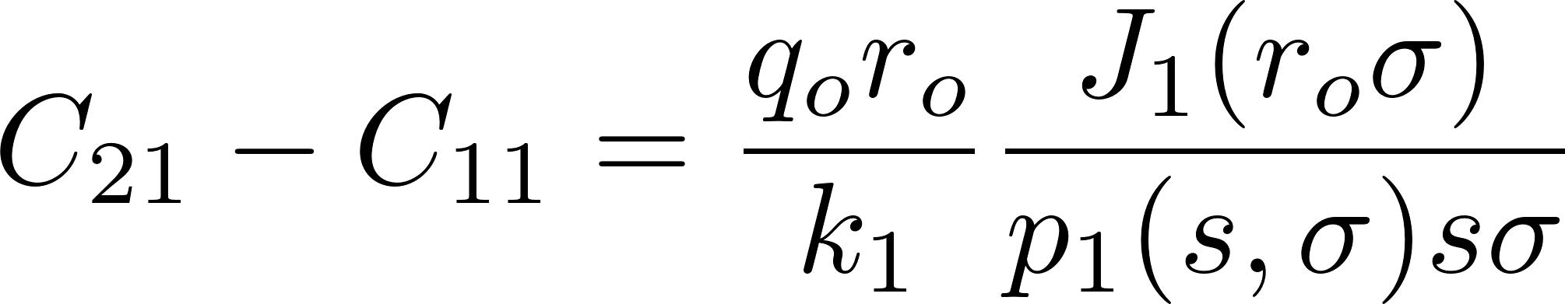
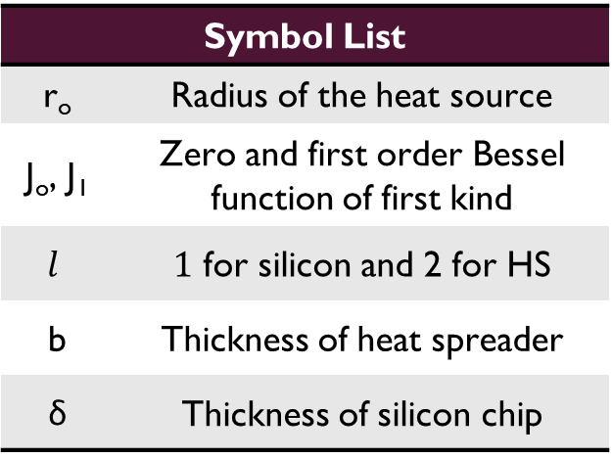
ARCHITECTURAL THERMAL SIMULATIONS
General solution:
Symbol List
r_{o} | Radius of the heat source
J_{o}, J₁ | Zero and first order Bessel function of first kind
$$l$$ | $1$ for silicon and 2 for HS
b | Thickness of heat spreader
δ | Thickness of silicon chip
For a particular solution, we take the Hankel transform of the boundary conditions and apply them to the obtained general solution.
We obtain a set of four linear equations, and we solve them to obtain the coefficients.

Slide 14
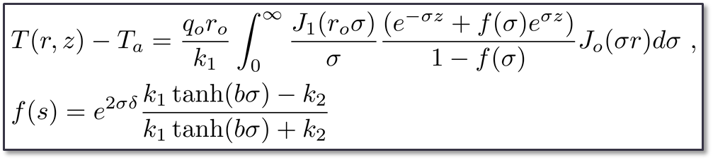
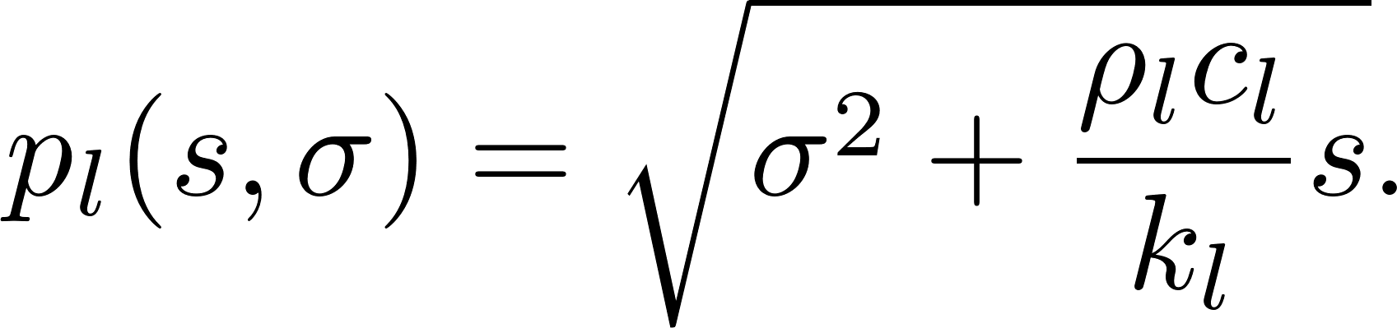
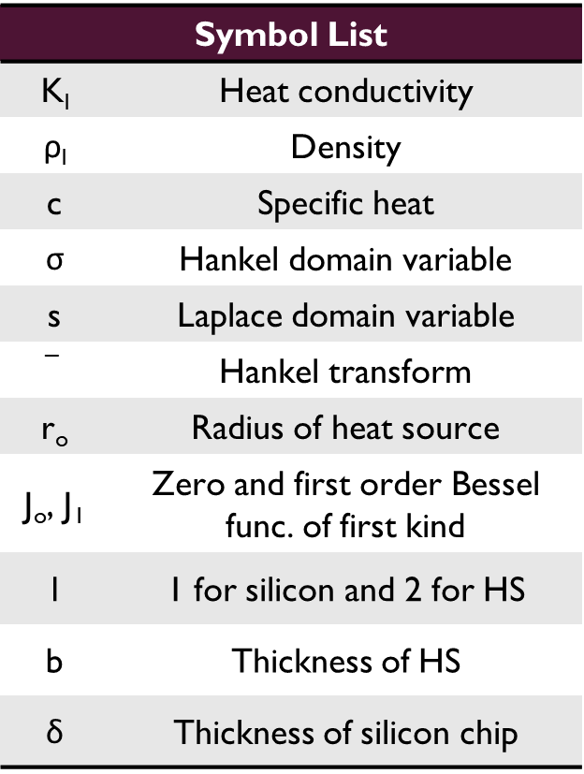
ARCHITECTURAL THERMAL SIMULATIONS
Steady state analytical solution:
Transient analytical solution:
Symbol List
K_{l} | Heat conductivity
ρ_{l} | Density
c | Specific heat
σ | Hankel domain variable
s | Laplace domain variable
$$−$$ | Hankel transform
r_{o} | Radius of heat source
J_{o}, J₁ | Zero and first order Bessel func. of first kind
l | 1 for silicon and 2 for HS
b | Thickness of HS
δ | Thickness of silicon chip
σ

Slide 15
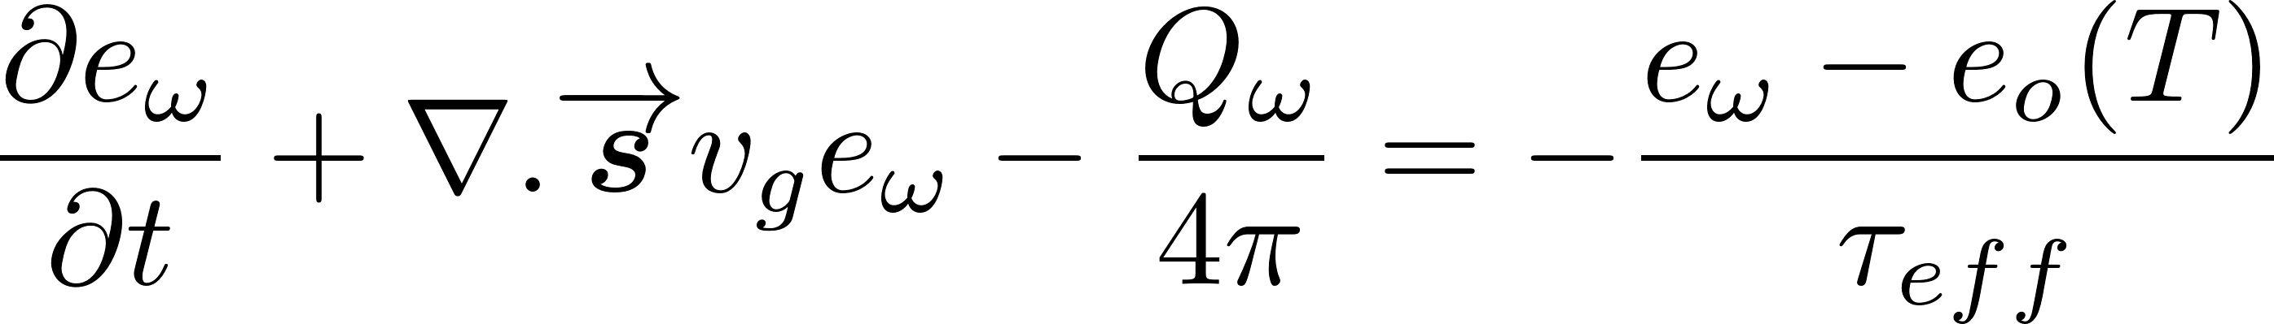
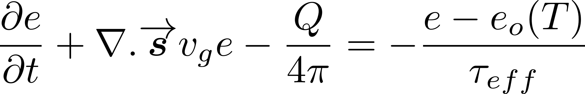
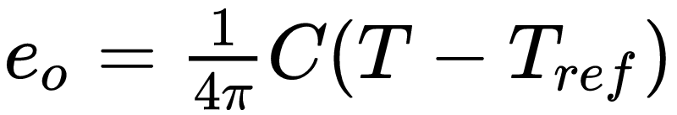
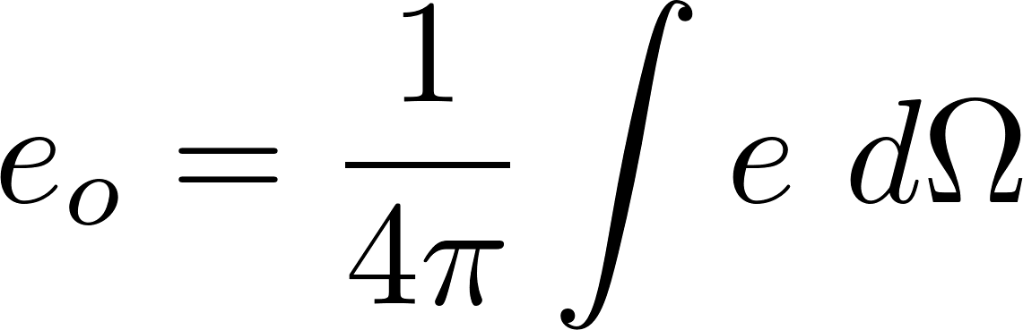
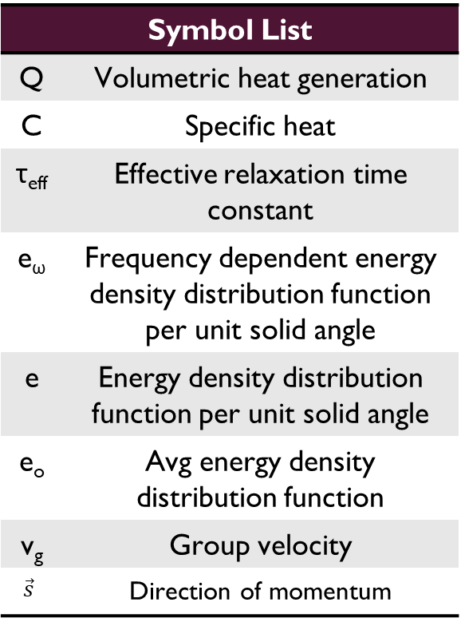
NANOSCALE THERMAL SIMULATIONS: BTE
Boltzmann transport equation (BTE) under Bhatnagar–Gross–Krook approximation:
Symbol List
Q | Volumetric heat generation
C | Specific heat
τ_{eff} | Effective relaxation time constant
e_{ω} | Frequency dependent energy density distribution function per unit solid angle
e | Energy density distribution function per unit solid angle
e_{o} | Avg energy density distribution function
v_{g} | Group velocity
$$\vec{s}$$ | Direction of momentum
Gray Boltzmann transport equation:
Gray BTE is frequency independent. It assumes that all phonons have the same relaxation time and group velocity.
Reduction in complexity

Slide 16
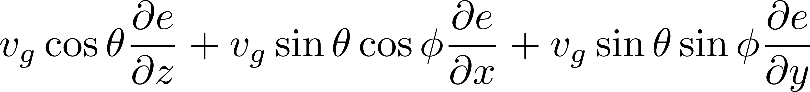
NANOSCALE THERMAL SIMULATIONS
Gray Boltzmann transport equation:
Symbol List
Q | Volumetric heat generation
ξ_{x},ξ_{y},ξ_{z} | Spatial frequencies(x, y, z)
ξ | √ ξ²_{x} ξ²_{y} ξ²_{z}
η | Temporal frequency
~ | Represents Fourier transform
Λ | Mean free path
Using the Fourier transform:

Slide 17
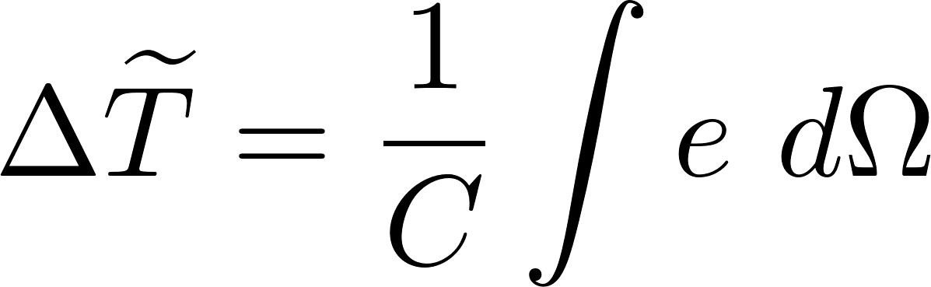
NANOSCALE THERMAL SIMULATIONS

Slide 18
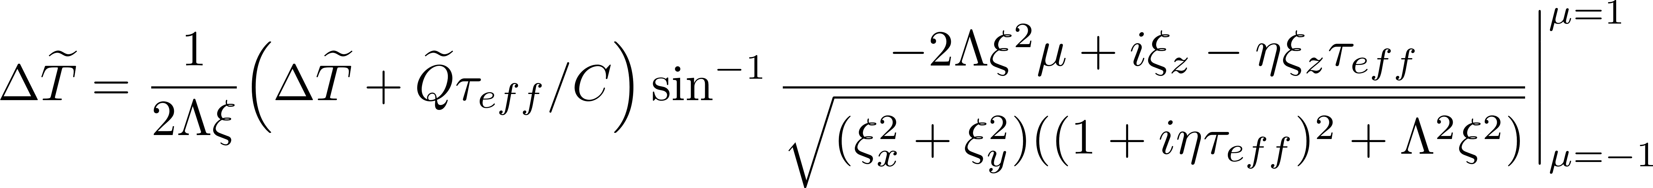
NANOSCALE THERMAL SIMULATIONS

Slide 19
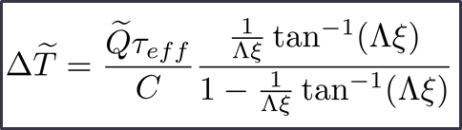
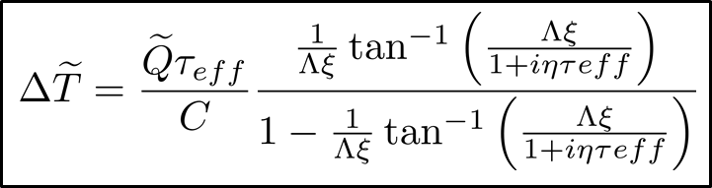
NANOSCALE THERMAL SIMULATIONS
Steady state analytical solution:
Transient analytical solution:
Temperature profile can be obtained using simple convolution.
Symbol List
Q | Volumetric heat generation
ξ_{x},ξ_{y},ξ_{z} | Spatial frequencies(x, y, z)
ξ | √ ξ²_{x} ξ²_{y} ξ²_{z}
η | Temporal frequency
~ | Represents Fourier transform
Λ | Mean free path

Slide 20
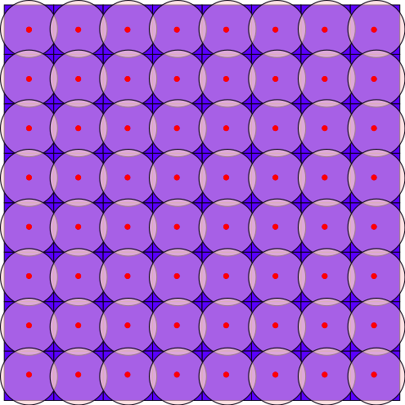
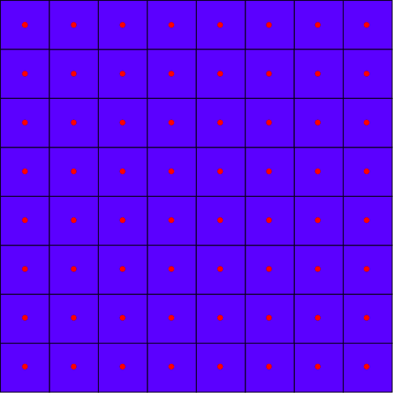
CIRCLE TO SQUARE MAPPING
The obtained solution is for a circular source but the floorplan elements in real chips/SoCs are rectangular
We need to map circular point sources to rectangular/square sources
We sample our Green’s function solution at sample points obtained by discretizing the chip into a grid
Sampling points
Sampling points
Smallest grid
Equiarea circle

Slide 21

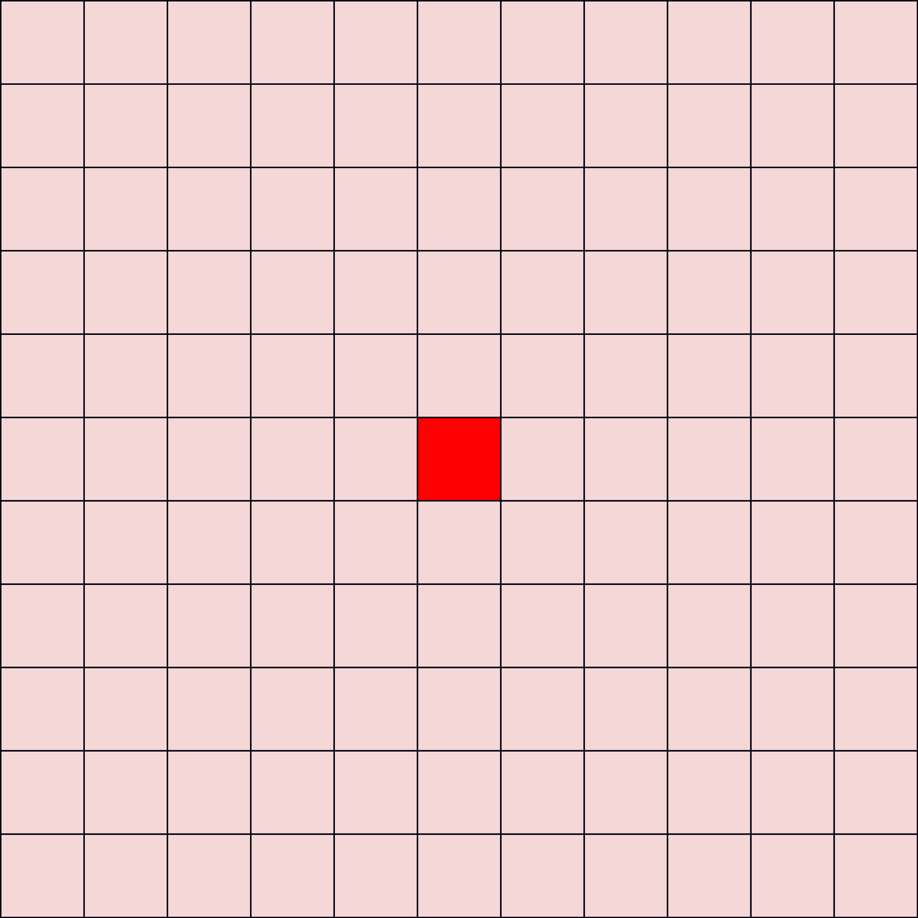
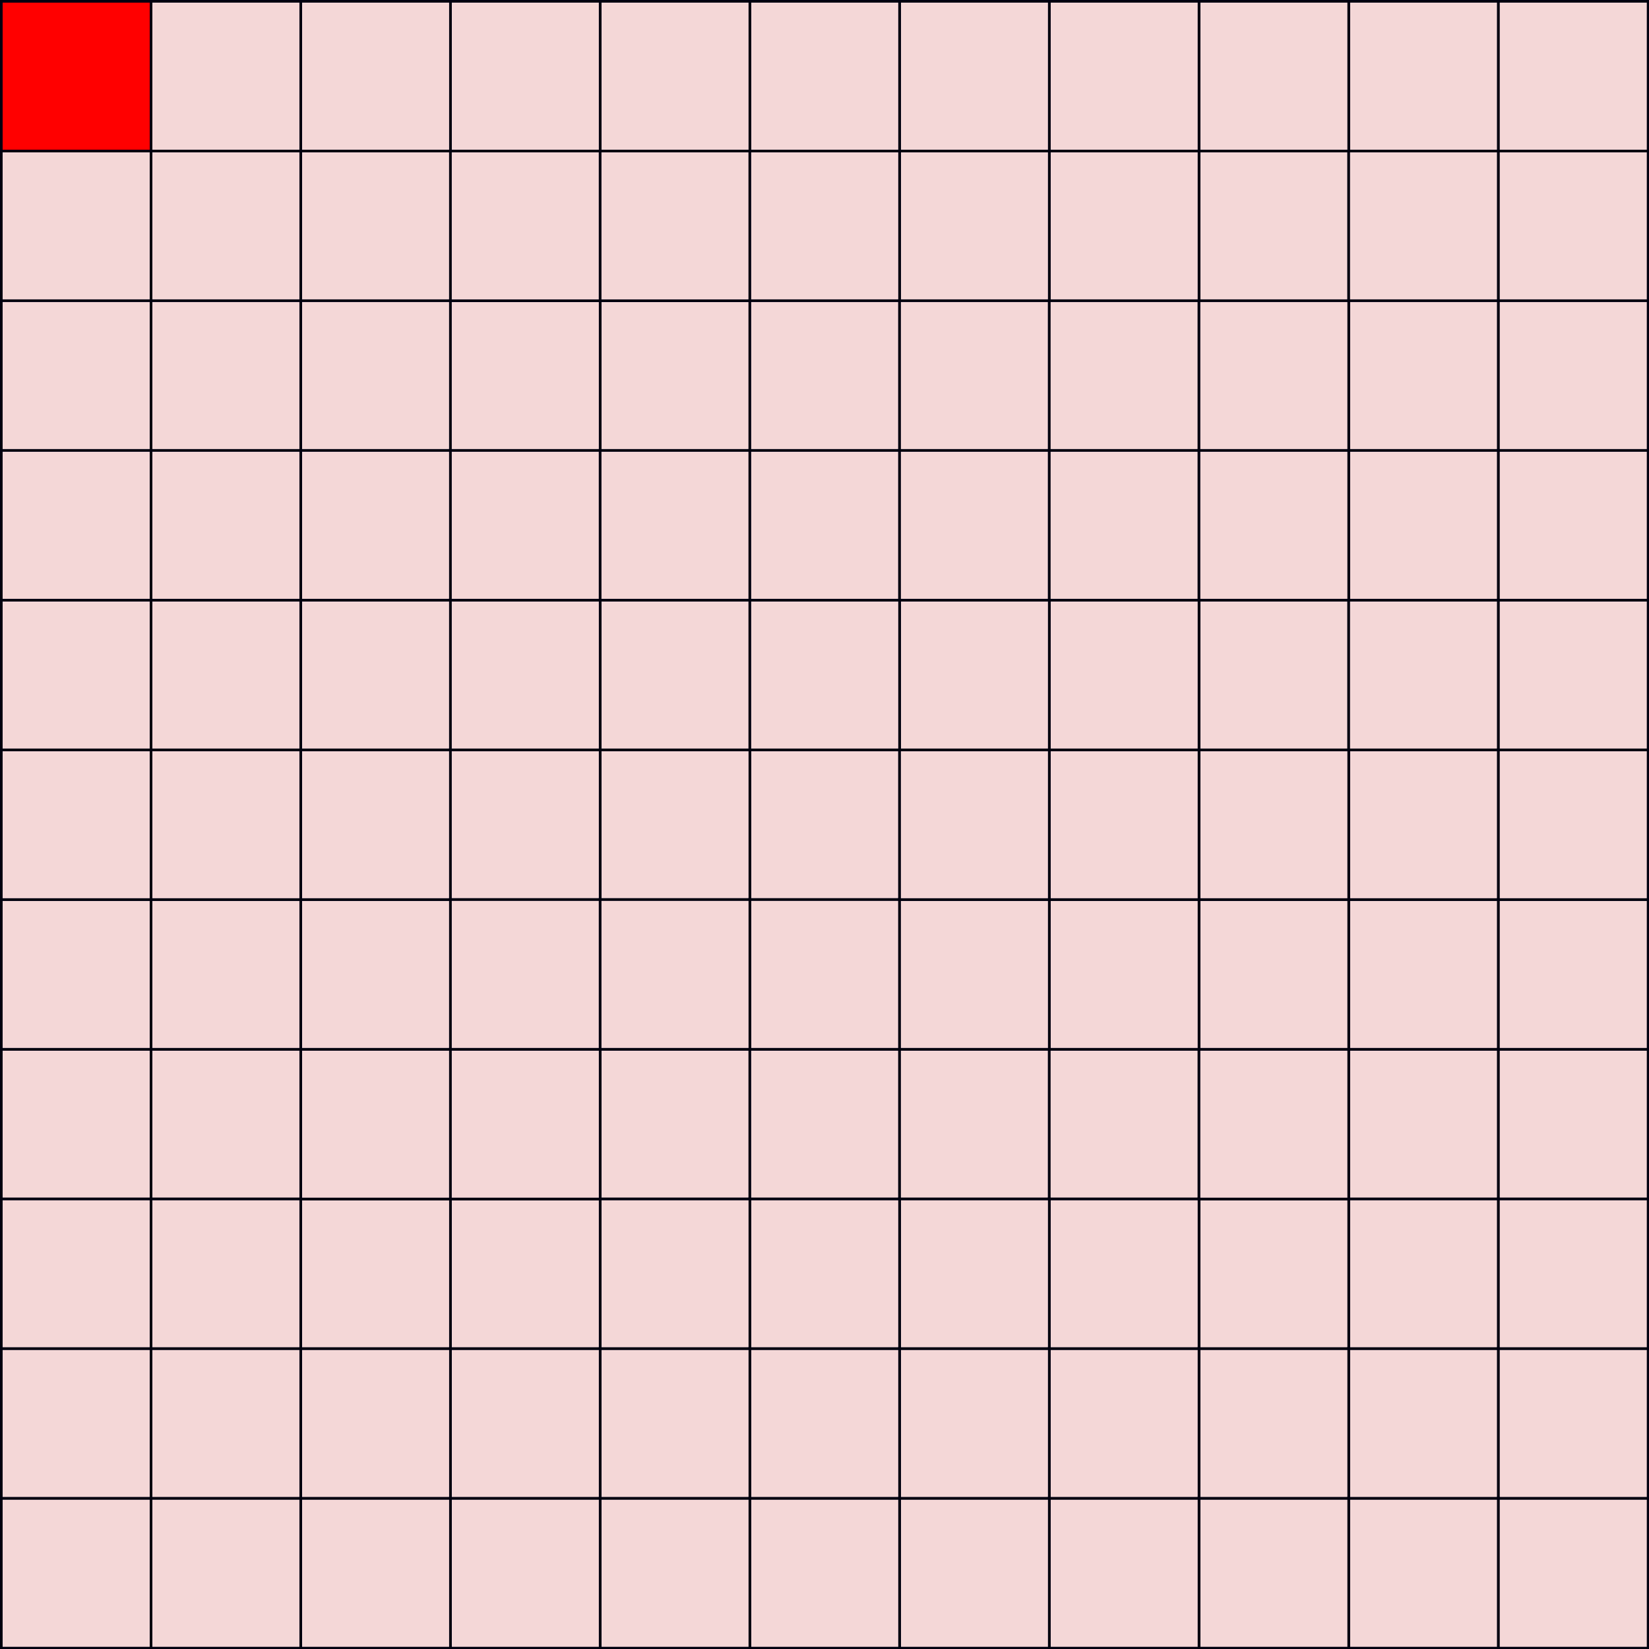
EDGE and CORNER EFFECTS
Temperature suddenly drops to zero

Slide 22
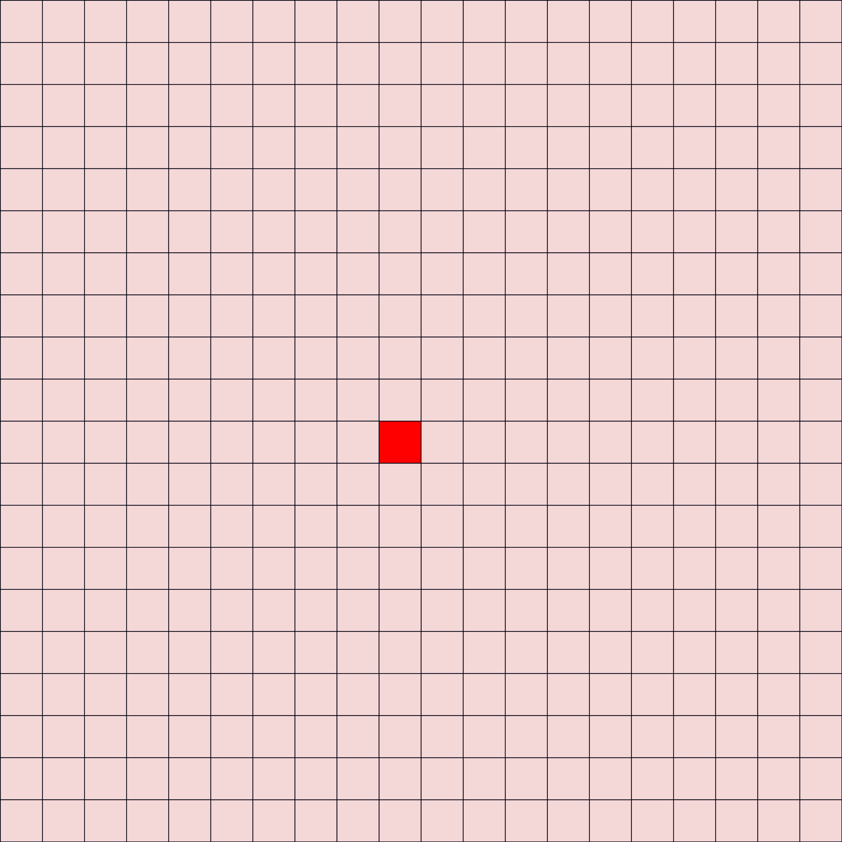

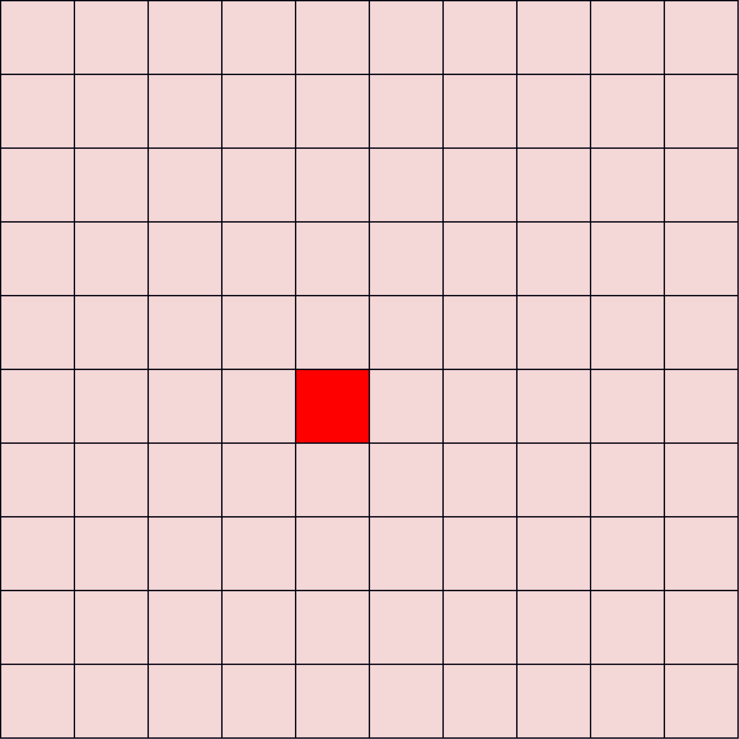
Extended Green’s function
2x size of the chip
Extended Green’s function

Slide 23


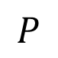
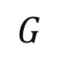
Full chip temperature Calculation
Make the power matrix 2 times the original size by zero padding
$$G$$
$$⊛$$
$$P$$
Final temperature
Folding

Slide 24
System Details
All simulations were done on a Dell OptiPlex 3010 desktop
Dell OptiPlex 3010 specification:
Intel(R) Core(TM) i7-3770S CPU @ 3.10GHz
8 GB DDR3 RAM
Operating system: Ubuntu 18.04

Slide 25
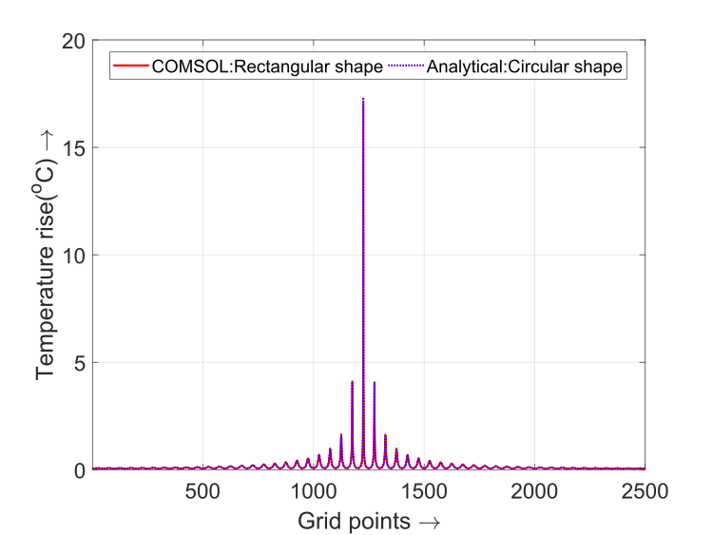
NANOTHERM RESULTS: CIRCLE TO SQUARE MAPPING
We compare the analytical model against a commercial CFD solver COMSOL.
Speedup over COMSOL: 3719X
Error < 3%
Steady state Green’s function

Slide 26
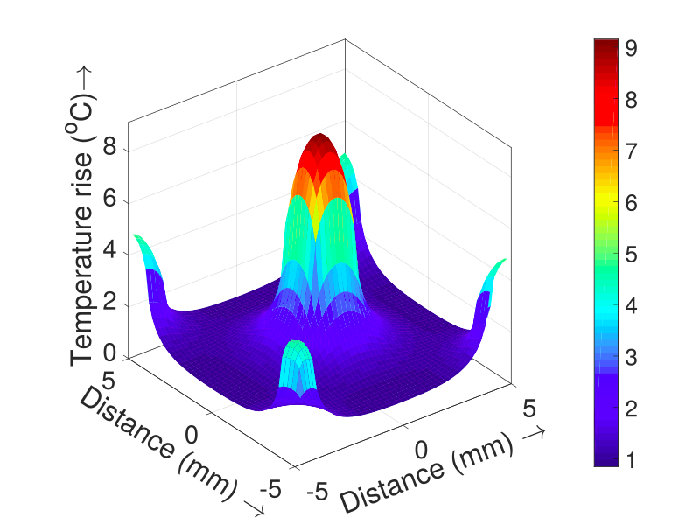
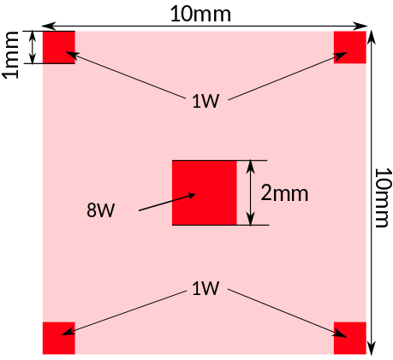
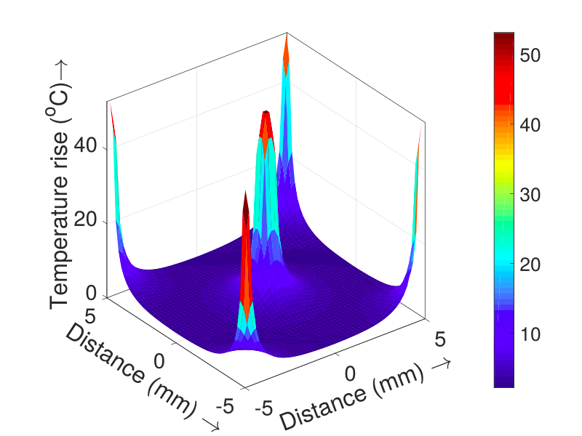
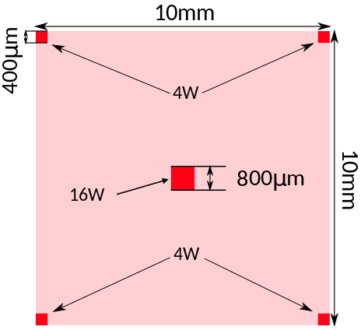
NANOTHERM RESULTS: FOURIER EQUATION
Full chip steady state
Power profile
Thermal profile
Case 1:
Error < 2 %
Speedup over
COMSOL: 3719X
Case 2:
Error < 3%

Slide 27
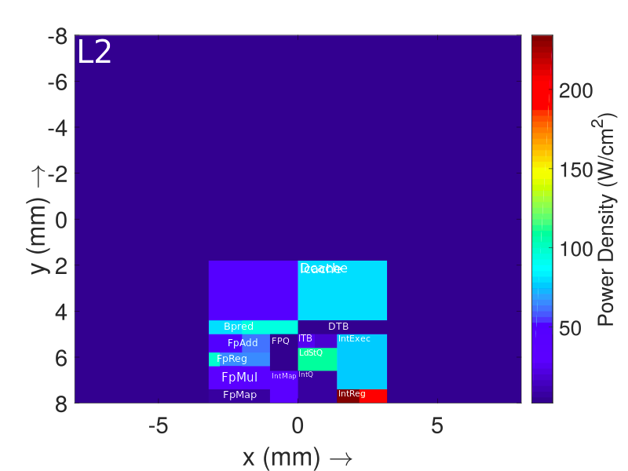
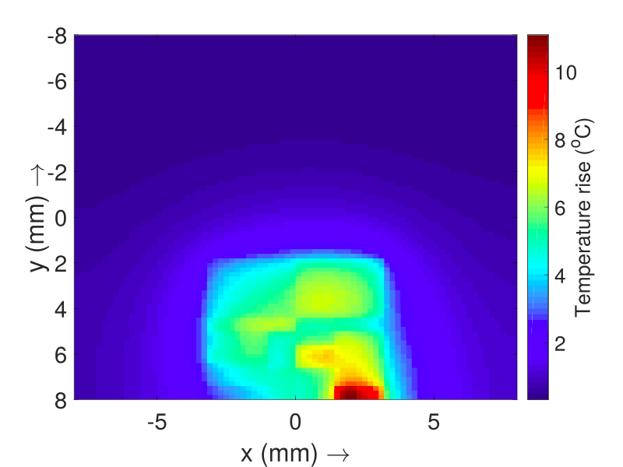
NANOTHERM RESULTS: FOURIER EQUATION
Case 3 - Alpha21264 : Full chip steady state
Speedup over
COMSOL: 3719X
Power profile
Thermal profile
Error = 3%

Slide 28
NANOTHERM RESULTS: FOURIER EQUATION
Case 4 - Intel Gainestown dual core : Full chip steady state
L3
LSU
L2
EU
IFU
RU
MMU
LSU
L2
EU
IFU
RU
MMU
Speedup over
COMSOL: 3719X
Error < 3%
Power profile
Thermal profile

Slide 29
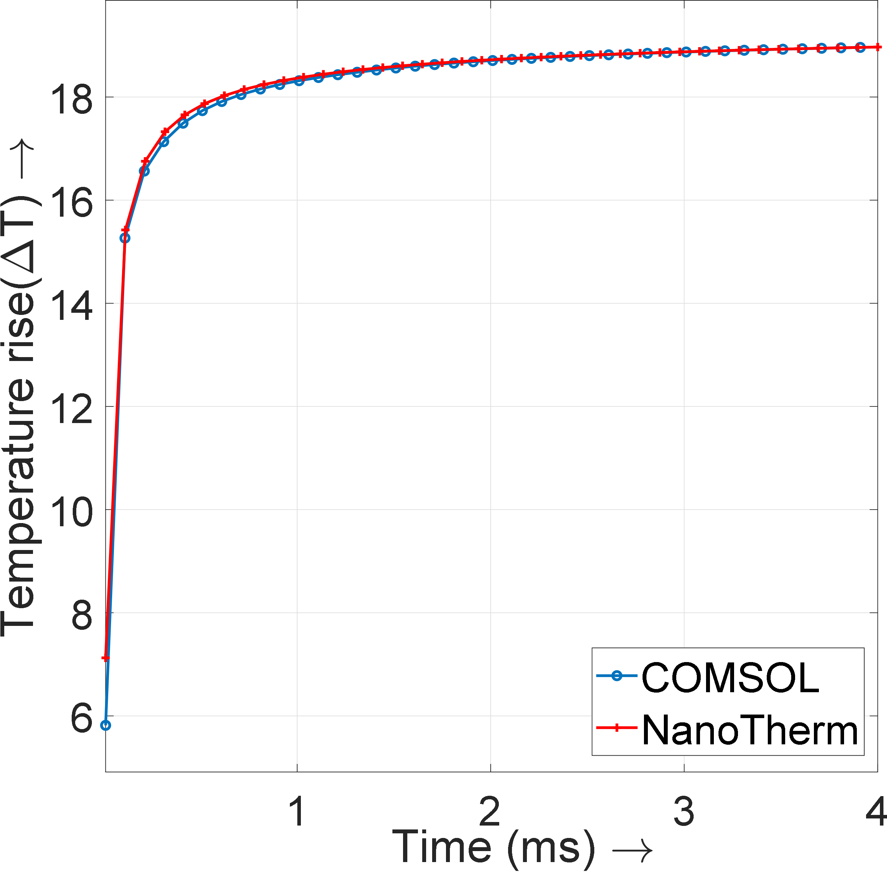
NANOTHERM RESULTS: FOURIER EQUATION
We compare the analytical model against a commercial CFD solver COMSOL.
Maximum error for transient simulation: 1%
Speedup over
COMSOL: 724X
Transient Step Response

Slide 30
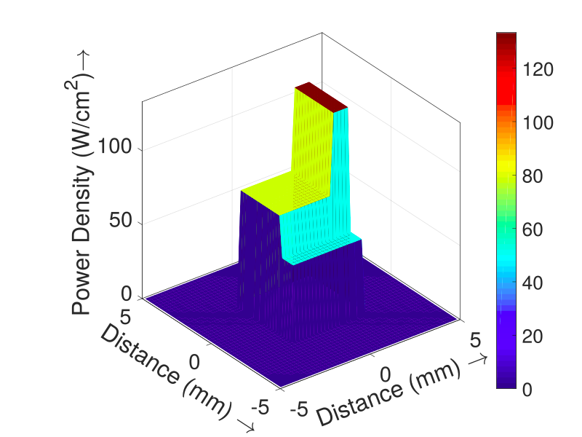
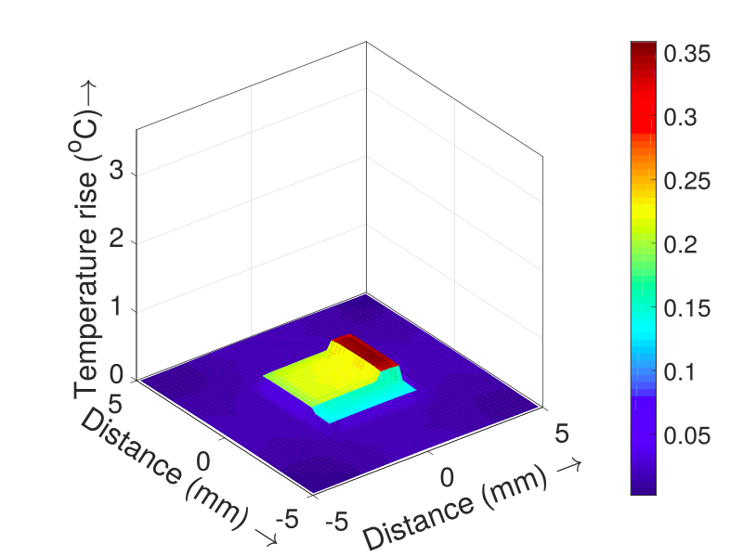
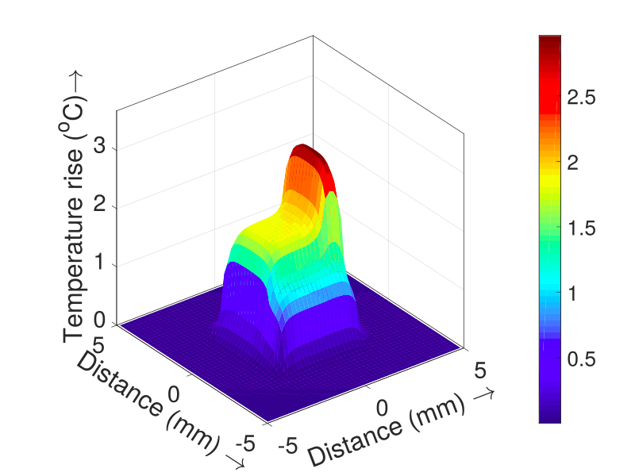
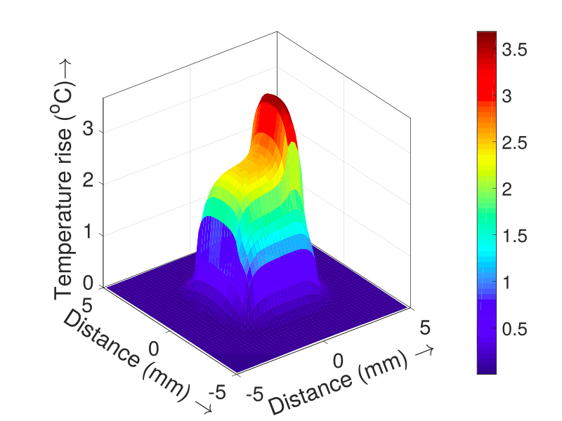
NANOTHERM RESULTS: FOURIER EQUATION
Full chip transient:
Power profile
Thermal profile
at t = 0.01 ms
Thermal profile
at t = 2 ms
Thermal profile
at t = 4 ms
Error < 2%

Slide 31

NANOSCALE RESULTS: BTE
We performed the simulation for a 60nm*45nm*20nm channel FET
We compare the analytical model against ThermalScope.
Error = 2%
Speedup over
ThermalScope: 668X
Steady state

Slide 32

NANOSCALE RESULTS: BTE
We performed the simulation for a 60nm*45nm*20nm channel FET
Error = 3%
Speedup over
ThermalScope: 73X
Transient

Slide 33
NANOSCALE RESULTS: SUMMARY
Simulator | Fourier heat equation |  | BTE
 | Steady | Transient | Steady | Transient
Hotspot | 1s | 36s | - | -
3DICE | 1.36s | 1.77s | - | -
COMSOL | 305s | 3005s | - | -
ThermalScope | 11.1s | 35.55s | 2206s | 2888s
NanoTherm | 0.082s | 4.15s | 3.3s | 39.5s

Slide 34
COMPARISON OF EXECUTION TIME FOR FOURIER SOLUTION
3005s
305s

Slide 35
COMPARISON OF EXECUTION TIME FOR BTE SOLUTION
2206s
2888s

Slide 36
Conclusion
We have developed a full chip thermal estimation method incorporating nanoscale effects.
In this work we have successfully computed the closed form solution for the Fourier and BTE equations in the transform domain.​
The solution was obtained for all settings: steady-state and transient​
The analytical solution is much faster than FEM-based solvers like COMSOL, ThermalScope, HotSpot and 3D-ICE

Slide 37

37

